Slide 1

CSE 101 - COMPUTER PROGRAMMING I Introduction
Joseph LEDET
Department of Computer Engineering
Akdeniz University
josephledet@akdeniz.edu.tr

Slide 2
What is Engineering?
Engineering is…
Analyzing problems
Solving problems
Using tools to create solutions
If a tool does not exist, an engineer may need to create the tool
Engineering is not…
Memorizing
Answering questions
Finding the one right answer
An Engineer does not claim someone else’s solution as their own

Slide 3
Algorithm
What is an algorithm?
Components of an algorithm
How to express algorithms

Slide 4
Solving problems
How to solve a problem:
Brute Force
Lucky Guess
Trial-and-Error
Experience (your own or someone else’s)
Scientifically/Algorithmically

Slide 5
Algorithm
Sequence of instructions describing how to accomplish a task
Note: Not actually performing the instructions
Examples
Cooking recipe
Assembly instructions
Directions for driving from Antalya to Ankara
Instructions for installing software (such as Java)

Slide 6
Install Software algorithm
Open web browser
Go to
https://www.oracle.com/java/technologies/javase-jdk15-downloads.html
Click “jdk-15_windows-x64_bin.exe”
Follow instructions

Slide 7
Example – making ayran
Put 500 grams of yogurt into a mixer
Add ½ liter water
Add some salt
Turn on mixer until contents are smooth
Enjoy!

Slide 8
Components of an algorithm
Values and variables (500 grams of yogurt)
Instructions (Add ½ liter water)
Sequences (Step 1 then 2)
Procedures (Turn on mixer)
Selections (if some condition is true, do something)
Repetitions (… until smooth)
Documentation

Slide 9

Values and variables
Values
Represent quantities, amounts, or measurements
May be one of many different types (number, text, other)
Variables
Containers for values
Example
This jar (Variable) can contain 10 cookies (Value)

Slide 10
Instructions and sequence
Instructions
Directions to perform an action on values and variables
Examples
Put (instruction) 500 grams of yogurt into the mixer
Add (instruction) ½ liter of water
Sequence
The order of a program is important
What if we performed the corrected ayran recipe in reverse order?

Slide 11
Procedure
A defined and named sequence of instructions
Can refer to it by name rather than repeating the same instructions many times
Examples
Mix – can include instructions to close the lid, make sure it is plugged in, press the button, etc.
Walk

Slide 12
Selection
Instruction to decide which of two possible sequences is performed
Based on a true/false condition
Example
If I like ayran (condition), then drink (one sequence), otherwise, say “No thank you” (other sequence)
If class is over, then leave the meeting and enjoy the weekend, otherwise, remain online
Can have multiple conditions
If class is over AND I don’t have questions…

Slide 13
Repetition
Similar to selection but as long as condition is true, repeat sequence
Test the condition, if true perform instructions, repeat…
Also known as iteration or loop
Example
Mix (instruction) until (repetition keyword) smooth (condition)
While (repetition keyword) teacher is speaking (condition) pay attention and take notes (instruction)

Slide 14
Documentation
Records what the algorithm does
Describes how it is accomplished
Explains the purpose of components
Notes restrictions or expectations
Example
“A recipe for making authentic, tasty ayran”
“Taking notes is a terrific way to learn the information presented”

Slide 15
Algorithm Design
Start with the desired goal of the algorithm
Divide into smaller activities
Divide these into even smaller activities until each resulting activity is easily performed (possibly in a single instruction)
Example
Learning

Slide 16
Learning
Read lecture notes
Read textbook
Read exercise
Design algorithm
Code solution
Test and document
Record insights
Read
Make notes
Prepare questions
Attend lecture
Listen and think
Complete prac.
Attend tutorials
Record answers to questions
Revise notes
Prepare
Study
Reinforce
Learn

Slide 17
Expressing Algorithms
Natural Language
Pseudocode
Flowcharts
Programming Languages

Slide 18
Pseudocode
If student’s grade is greater than or equal to 90
Print “A”
Else If student’s grade is greater than or equal to 80
Print “B”
Else If student’s grade is greater than or equal to 70
Print “C”
Else If student’s grade is greater than or equal to 60
Print “D”
Else
Print “F”

Slide 19
Pseudocode
Set total to 0
Set classCount to 0
While more grades exist to input
Input the next grade
Add grade to total (total = total + grade)
Increment classCount (classCount = classCount + 1)
Set classAverage to total divided by classCount
(classAverage = total / classCount)

Slide 20
Flowcharts
Visual representation of an algorithm
Symbols mostly used Less used
Start/End Document
Arrows Magnetic Tape
Instructions Display
Input/Output Manual Input
Conditional (Decision)

Slide 21
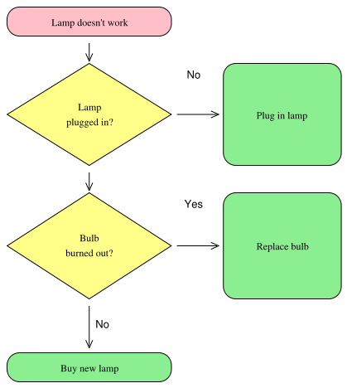
Flowchart example
From https://en.wikipedia.org/wiki/Flowchart

Slide 22
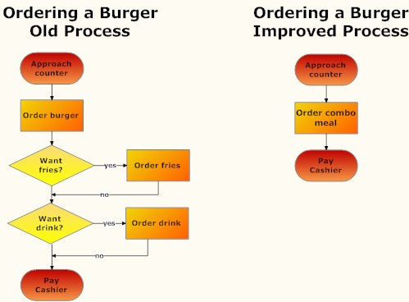
Flowchart example
From http://www.smartdraw.com/

Slide 23
Objectives
To understand computer basics, programs, and operating systems (§§1.2–1.4).
To describe the relationship between Java and the World Wide Web (§1.5).
To understand the meaning of Java language specification, API, JDK, and IDE (§1.6).
To write a simple Java program (§1.7).
To display output on the console (§1.7).
To explain the basic syntax of a Java program (§1.7).
To create, compile, and run Java programs (§1.8).
To use sound Java programming style and document programs properly (§1.9).
To explain the differences between syntax errors, runtime errors, and logic errors (§1.10).
To develop Java programs using NetBeans (§1.11).
To develop Java programs using Eclipse (§1.12).
23

Slide 24
What is a Computer?
A computer consists of a CPU, memory, hard disk, floppy disk, monitor, printer, and communication devices.
24

Slide 25
CPU
The central processing unit (CPU) is the brain of a computer. It retrieves instructions from memory and executes them. The CPU speed is measured in megahertz (MHz), with 1 megahertz equaling 1 million pulses per second. The speed of the CPU has been improved continuously. If you buy a PC now, you can get an Intel Pentium 4 Processor at 3 gigahertz (1 gigahertz is 1000 megahertz).
25

Slide 26
Memory
Memory is to store data and program instructions for CPU to execute. A memory unit is an ordered sequence of bytes, each holds eight bits. A program and its data must be brought to memory before they can be executed. A memory byte is never empty, but its initial content may be meaningless to your program. The current content of a memory byte is lost whenever new information is placed in it.
26

Slide 27
How Data is Stored?
Data of various kinds, such as numbers, characters, and strings, are encoded as a series of bits (zeros and ones). Computers use zeros and ones because digital devices have two stable states, which are referred to as zero and one by convention. The programmers need not to be concerned about the encoding and decoding of data, which is performed automatically by the system based on the encoding scheme. The encoding scheme varies. For example, character ‘J’ is represented by 01001010 in one byte. A small number such as three can be stored in a single byte. If computer needs to store a large number that cannot fit into a single byte, it uses a number of adjacent bytes. No two data can share or split a same byte. A byte is the minimum storage unit.
27

Slide 28
Storage Devices
Memory is volatile, because information is lost when the power is off. Programs and data are permanently stored on storage devices and are moved to memory when the computer actually uses them. There are three main types of storage devices:Disk drives (hard disks and floppy disks), CD drives (CD-R and CD-RW), and Tape drives.
28

Slide 29
Output Devices: Monitor
The monitor displays information (text and graphics). The resolution and dot pitch determine the quality of the display.
29

Slide 30
Monitor Resolution and Dot Pitch
resolution
The screen resolution specifies the number of pixels in horizontal and vertical dimensions of the display device. Pixels (short for “picture elements”) are tiny dots that form an image on the screen. A common resolution for a 17-inch screen, for example, is 1,024 pixels wide and 768 pixels high. The resolution can be set manually. The higher the resolution, the sharper and clearer the image is.
dot pitch
The dot pitch is the amount of space between pixels, measured in millimeters. The smaller the dot pitch, the sharper the display.
30

Slide 31
Communication Devices
A regular modem uses a phone line and can transfer data in a speed up to 56,000 bps (bits per second). A DSL (digital subscriber line) also uses a phone line and can transfer data in a speed 20 times faster than a regular modem. A cable modem uses the TV cable line maintained by the cable company. A cable modem is as fast as a DSL. Network interface card (NIC) is a device to connect a computer to a local area network (LAN). The LAN is commonly used in business, universities, and government organizations. A typical type of NIC, called 10BaseT, can transfer data at 10 mbps (million bits per second).
31

Slide 32
Programs
Computer programs, known as software, are instructions to the computer.
You tell a computer what to do through programs. Without programs, a computer is an empty machine. Computers do not understand human languages, so you need to use computer languages to communicate with them.
Programs are written using programming languages.
32

Slide 33
Programming Languages
Machine Language Assembly Language High-Level Language
Machine language is a set of primitive instructions built into every computer. The instructions are in the form of binary code, so you have to enter binary codes for various instructions. Program with native machine language is a tedious process. Moreover the programs are highly difficult to read and modify. For example, to add two numbers, you might write an instruction in binary like this:
1101101010011010
33

Slide 34
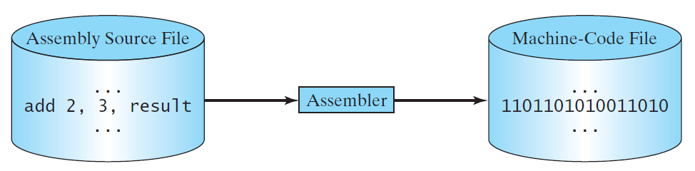
Programming Languages
Machine Language Assembly Language High-Level Language
Assembly languages were developed to make programming easy. Since the computer cannot understand assembly language, however, a program called assembler is used to convert assembly language programs into machine code. For example, to add two numbers, you might write an instruction in assembly code like this:
ADDF3 R1, R2, R3
34

Slide 35
Programming Languages
Machine Language Assembly Language High-Level Language
The high-level languages are English-like and easy to learn and program. For example, the following is a high-level language statement that computes the area of a circle with radius 5:
area = 5 * 5 * 3.1415;
35

Slide 36
Popular High-Level Languages
36

Slide 37
Interpreting/Compiling Source Code
A program written in a high-level language is called a source program or source code. Because a computer cannot understand a source program, a source program must be translated into machine code for execution. The translation can be done using another programming tool called an interpreter or a compiler.
37

Slide 38
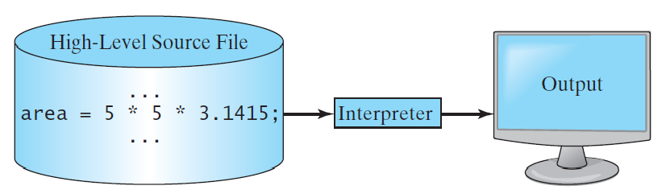
Interpreting Source Code
An interpreter reads one statement from the source code, translates it to the machine code or virtual machine code, and then executes it right away, as shown in the following figure. Note that a statement from the source code may be translated into several machine instructions.
38

Slide 39
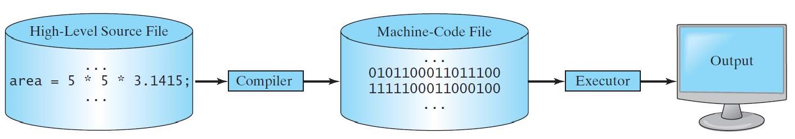
Compiling Source Code
A compiler translates the entire source code into a machine-code file, and the machine-code file is then executed, as shown in the following figure.
39

Slide 40
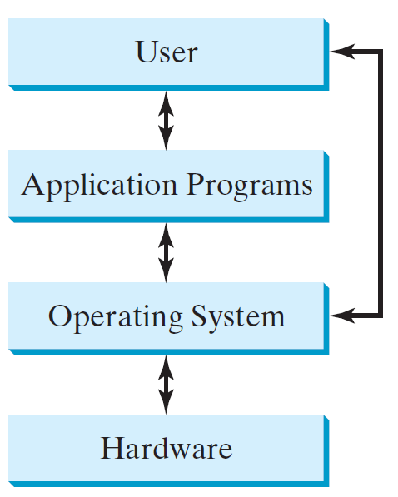
Operating Systems
The operating system (OS) is a program that manages and controls a computer’s activities. The popular operating systems for general-purpose computers are Microsoft Windows, Mac OS, and Linux. Application programs, such as a Web browser or a word processor, cannot run unless an operating system is installed and running on the computer.
40

Slide 41
Why Java?
The answer is that Java enables users to develop and deploy applications on the Internet for servers, desktop computers, and small hand-held devices. The future of computing is being profoundly influenced by the Internet, and Java promises to remain a big part of that future. Java is the Internet programming language.
Java is a general purpose programming language.
Java is the Internet programming language.
41

Slide 42
Java, Web, and Beyond
Java can be used to develop standalone applications.
Java can be used to develop applications running from a browser.
Java can also be used to develop applications for hand-held devices.
Java can be used to develop applications for Web servers.
42

Slide 43
Java’s History
James Gosling and Sun Microsystems
Oak
Java, May 20, 1995, Sun World
HotJava
The first Java-enabled Web browser
Early History Website:
http://www.java.com/en/javahistory/index.jsp
43

Slide 44
Companion Website
Characteristics of Java
Java Is Simple
Java Is Object-Oriented
Java Is Distributed
Java Is Interpreted
Java Is Robust
Java Is Secure
Java Is Architecture-Neutral
Java Is Portable
Java's Performance
Java Is Multithreaded
Java Is Dynamic
www.cs.armstrong.edu/liang/JavaCharacteristics.pdf
44

Slide 45
Companion Website
Characteristics of Java
Java Is Simple
Java Is Object-Oriented
Java Is Distributed
Java Is Interpreted
Java Is Robust
Java Is Secure
Java Is Architecture-Neutral
Java Is Portable
Java's Performance
Java Is Multithreaded
Java Is Dynamic
Java is partially modeled on C++, but greatly simplified and improved. Some people refer to Java as "C++--" because it is like C++ but with more functionality and fewer negative aspects.
45

Slide 46
Companion Website
Characteristics of Java
Java Is Simple
Java Is Object-Oriented
Java Is Distributed
Java Is Interpreted
Java Is Robust
Java Is Secure
Java Is Architecture-Neutral
Java Is Portable
Java's Performance
Java Is Multithreaded
Java Is Dynamic
Java is inherently object-oriented. Although many object-oriented languages began strictly as procedural languages, Java was designed from the start to be object-oriented. Object-oriented programming (OOP) is a popular programming approach that is replacing traditional procedural programming techniques.
One of the central issues in software development is how to reuse code. Object-oriented programming provides great flexibility, modularity, clarity, and reusability through encapsulation, inheritance, and polymorphism.
46

Slide 47
Companion Website
Characteristics of Java
Java Is Simple
Java Is Object-Oriented
Java Is Distributed
Java Is Interpreted
Java Is Robust
Java Is Secure
Java Is Architecture-Neutral
Java Is Portable
Java's Performance
Java Is Multithreaded
Java Is Dynamic
Distributed computing involves several computers working together on a network. Java is designed to make distributed computing easy. Since networking capability is inherently integrated into Java, writing network programs is like sending and receiving data to and from a file.
47

Slide 48
Companion Website
Characteristics of Java
Java Is Simple
Java Is Object-Oriented
Java Is Distributed
Java Is Interpreted
Java Is Robust
Java Is Secure
Java Is Architecture-Neutral
Java Is Portable
Java's Performance
Java Is Multithreaded
Java Is Dynamic
You need an interpreter to run Java programs. The programs are compiled into the Java Virtual Machine code called bytecode. The bytecode is machine-independent and can run on any machine that has a Java interpreter, which is part of the Java Virtual Machine (JVM).
48

Slide 49
Companion Website
Characteristics of Java
Java Is Simple
Java Is Object-Oriented
Java Is Distributed
Java Is Interpreted
Java Is Robust
Java Is Secure
Java Is Architecture-Neutral
Java Is Portable
Java's Performance
Java Is Multithreaded
Java Is Dynamic
Java compilers can detect many problems that would first show up at execution time in other languages.
Java has eliminated certain types of error-prone programming constructs found in other languages.
Java has a runtime exception-handling feature to provide programming support for robustness.
49

Slide 50
Companion Website
Characteristics of Java
Java Is Simple
Java Is Object-Oriented
Java Is Distributed
Java Is Interpreted
Java Is Robust
Java Is Secure
Java Is Architecture-Neutral
Java Is Portable
Java's Performance
Java Is Multithreaded
Java Is Dynamic
Java implements several security mechanisms to protect your system against harm caused by stray programs.
50

Slide 51
Companion Website
Characteristics of Java
Java Is Simple
Java Is Object-Oriented
Java Is Distributed
Java Is Interpreted
Java Is Robust
Java Is Secure
Java Is Architecture-Neutral
Java Is Portable
Java's Performance
Java Is Multithreaded
Java Is Dynamic
Write once, run anywhere
With a Java Virtual Machine (JVM), you can write one program that will run on any platform.
51

Slide 52
Companion Website
Characteristics of Java
Java Is Simple
Java Is Object-Oriented
Java Is Distributed
Java Is Interpreted
Java Is Robust
Java Is Secure
Java Is Architecture-Neutral
Java Is Portable
Java's Performance
Java Is Multithreaded
Java Is Dynamic
Because Java is architecture neutral, Java programs are portable. They can be run on any platform without being recompiled.
52

Slide 53
Companion Website
Characteristics of Java
Java Is Simple
Java Is Object-Oriented
Java Is Distributed
Java Is Interpreted
Java Is Robust
Java Is Secure
Java Is Architecture-Neutral
Java Is Portable
Java's Performance
Java Is Multithreaded
Java Is Dynamic
Java’s performance Because Java is architecture neutral, Java programs are portable. They can be run on any platform without being recompiled.
53

Slide 54
Companion Website
Characteristics of Java
Java Is Simple
Java Is Object-Oriented
Java Is Distributed
Java Is Interpreted
Java Is Robust
Java Is Secure
Java Is Architecture-Neutral
Java Is Portable
Java's Performance
Java Is Multithreaded
Java Is Dynamic
Multithread programming is smoothly integrated in Java, whereas in other languages you have to call procedures specific to the operating system to enable multithreading.
54

Slide 55
Companion Website
Characteristics of Java
Java Is Simple
Java Is Object-Oriented
Java Is Distributed
Java Is Interpreted
Java Is Robust
Java Is Secure
Java Is Architecture-Neutral
Java Is Portable
Java's Performance
Java Is Multithreaded
Java Is Dynamic
Java was designed to adapt to an evolving environment. New code can be loaded on the fly without recompilation. There is no need for developers to create, and for users to install, major new software versions. New features can be incorporated transparently as needed.
55

Slide 56
JDK Editions
Java Standard Edition (J2SE)
J2SE can be used to develop client-side standalone applications or applets.
Java Enterprise Edition (J2EE)
J2EE can be used to develop server-side applications such as Java servlets, Java ServerPages, and Java ServerFaces.
Java Micro Edition (J2ME).
J2ME can be used to develop applications for mobile devices such as cell phones.
This book uses J2SE to introduce Java programming.
56

Slide 57
Popular Java IDEs
NetBeans
Eclipse
IntelliJ
jGrasp
57

Slide 58

A Simple Java Program
Listing 1.1
// This program prints Welcome to Java!
public class Welcome {
public static void main(String[] args) {
System.out.println("Welcome to Java!");
}
}
Animation
Welcome
IMPORTANT NOTE: If you cannot run the buttons, see www.cs.armstrong.edu/liang/javaslidenote.doc.
Run
58

Slide 59

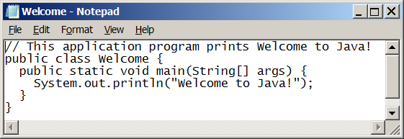
Creating and Editing Using NotePad
To use NotePad, type
notepad Welcome.java
from the DOS prompt.
59

Slide 60

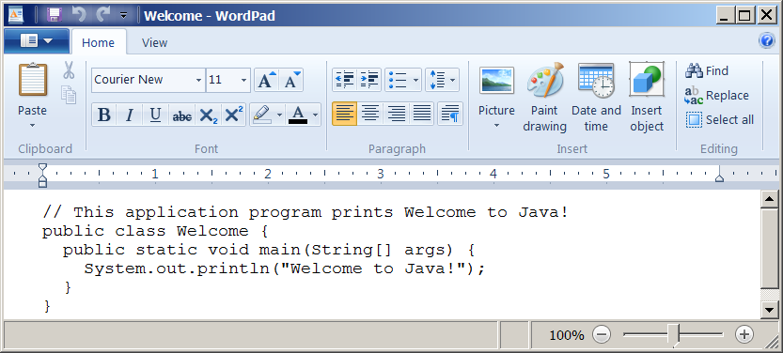
Creating and Editing Using WordPad
To use WordPad, type
write Welcome.java
from the DOS prompt.
60

Slide 61
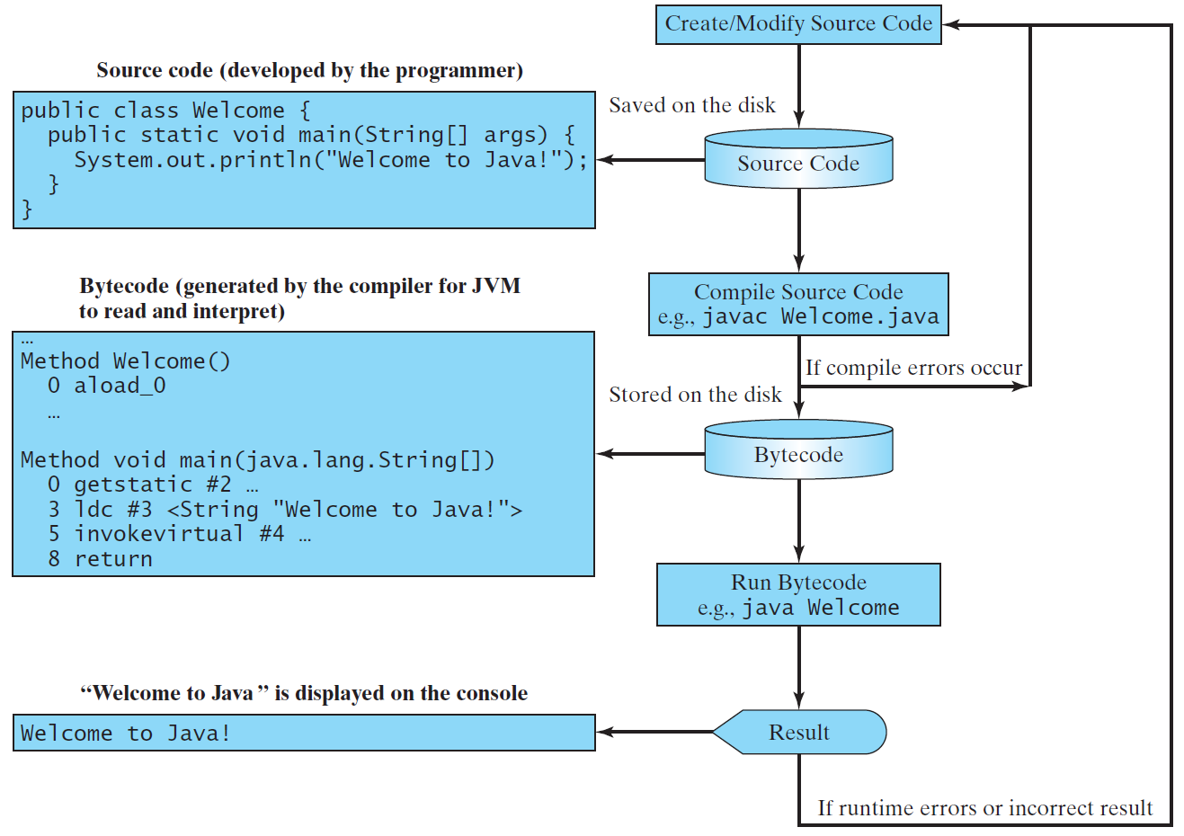
Creating, Compiling, and Running Programs
61

Slide 62
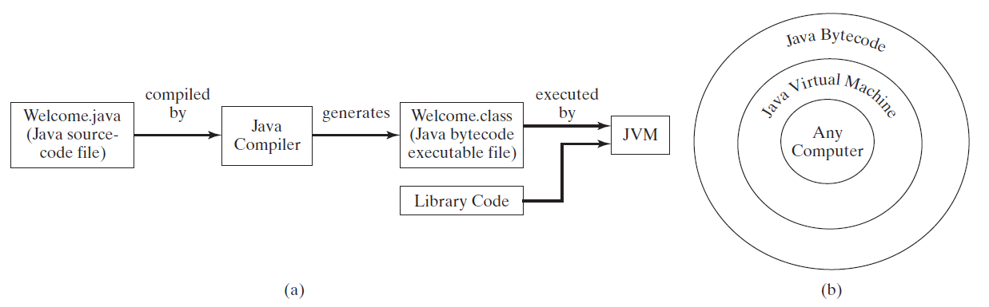
Compiling Java Source Code
You can port a source program to any machine with appropriate compilers. The source program must be recompiled, however, because the object program can only run on a specific machine. Nowadays computers are networked to work together. Java was designed to run object programs on any platform. With Java, you write the program once, and compile the source program into a special type of object code, known as bytecode. The bytecode can then run on any computer with a Java Virtual Machine, as shown below. Java Virtual Machine is a software that interprets Java bytecode.
62

Slide 63
animation
Trace a Program Execution
Enter main method
// This program prints Welcome to Java!
public class Welcome {
public static void main(String[] args) {
System.out.println("Welcome to Java!");
}
}
63

Slide 64
animation
Trace a Program Execution
Execute statement
// This program prints Welcome to Java!
public class Welcome {
public static void main(String[] args) {
System.out.println("Welcome to Java!");
}
}
64

Slide 65
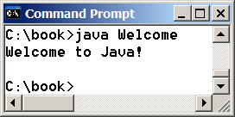
animation
Trace a Program Execution
// This program prints Welcome to Java!
public class Welcome {
public static void main(String[] args) {
System.out.println("Welcome to Java!");
}
}
print a message to the console
65

Slide 66

Two More Simple Examples
Animation
WelcomeWithThreeMessages
Run
Animation
ComputeExpression
Run
66

Slide 67
Companion Website
Supplements on the Companion Website
See Supplement I.B for installing and configuring JDK
See Supplement I.C for compiling and running Java from the command window for details
www.cs.armstrong.edu/liang/intro10e
67

Slide 68
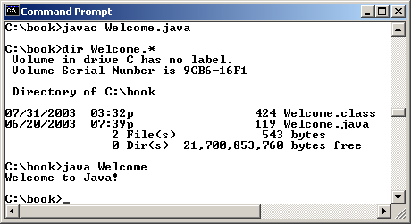
Companion Website
Compiling and Running Java from the Command Window
Set path to JDK bin directory
set path=c:\Program Files\java\jdk-15\bin
Set classpath to include the current directory
set classpath=.
Compile
javac Welcome.java
Run
java Welcome
68

Slide 69
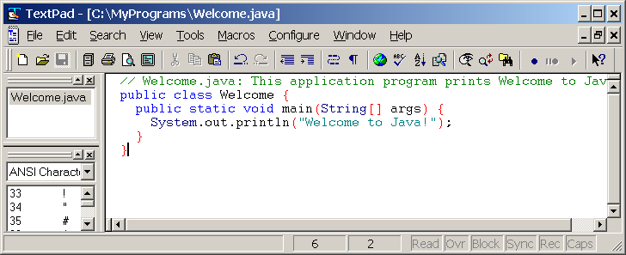
Compiling and Running Java from TextPad
Companion Website
See Supplement II.A on the Website for details
69

Slide 70
Anatomy of a Java Program
Class name
Main method
Statements
Statement terminator
Reserved words
Comments
Blocks
70

Slide 71
Class Name
Every Java program must have at least one class. Each class has a name. By convention, class names start with an uppercase letter. In this example, the class name is Welcome.
// This program prints Welcome to Java!
public class Welcome {
public static void main(String[] args) {
System.out.println("Welcome to Java!");
}
}
71

Slide 72
Main Method
Line 2 defines the main method. In order to run a class, the class must contain a method named main. The program is executed from the main method.
// This program prints Welcome to Java!
public class Welcome {
public static void main(String[] args) {
System.out.println("Welcome to Java!");
}
}
72

Slide 73
Statement
A statement represents an action or a sequence of actions. The statement System.out.println("Welcome to Java!") in the program in Listing 1.1 is a statement to display the greeting "Welcome to Java!“.
// This program prints Welcome to Java!
public class Welcome {
public static void main(String[] args) {
System.out.println("Welcome to Java!");
}
}
73

Slide 74
Statement Terminator
Every statement in Java ends with a semicolon (;).
// This program prints Welcome to Java!
public class Welcome {
public static void main(String[] args) {
System.out.println("Welcome to Java!");
}
}
74

Slide 75
Reserved words
Reserved words or keywords are words that have a specific meaning to the compiler and cannot be used for other purposes in the program. For example, when the compiler sees the word class, it understands that the word after class is the name for the class.
// This program prints Welcome to Java!
public class Welcome {
public static void main(String[] args) {
System.out.println("Welcome to Java!");
}
}
75

Slide 76
Blocks
A pair of braces in a program forms a block that groups components of a program.
76

Slide 77
Special Symbols
77

Slide 78
{ … }
// This program prints Welcome to Java!
public class Welcome {
public static void main(String[] args) {
System.out.println("Welcome to Java!");
}
}
78

Slide 79
( … )
// This program prints Welcome to Java!
public class Welcome {
public static void main(String[] args) {
System.out.println("Welcome to Java!");
}
}
79

Slide 80
;
// This program prints Welcome to Java!
public class Welcome {
public static void main(String[] args) {
System.out.println("Welcome to Java!");
}
}
80

Slide 81
// …
// This program prints Welcome to Java!
public class Welcome {
public static void main(String[] args) {
System.out.println("Welcome to Java!");
}
}
81

Slide 82
" … "
// This program prints Welcome to Java!
public class Welcome {
public static void main(String[] args) {
System.out.println("Welcome to Java!");
}
}
82

Slide 83
Programming Style and Documentation
Appropriate Comments
Naming Conventions
Proper Indentation and Spacing Lines
Block Styles
83

Slide 84
Appropriate Comments
Include a summary at the beginning of the program to explain what the program does, its key features, its supporting data structures, and any unique techniques it uses.
Include your name, class section, instructor, date, and a brief description at the beginning of the program.
84

Slide 85
Naming Conventions
Choose meaningful and descriptive names.
Class names:
Capitalize the first letter of each word in the name. For example, the class name ComputeExpression.
85

Slide 86
Proper Indentation and Spacing
Indentation
Indent two spaces.
Spacing
Use blank line to separate segments of the code.
86

Slide 87
Block Styles
Use end-of-line style for braces.
87

Slide 88
Programming Errors
Syntax Errors
Detected by the compiler
Runtime Errors
Causes the program to abort
Logic Errors
Produces incorrect result
88

